Slide 1
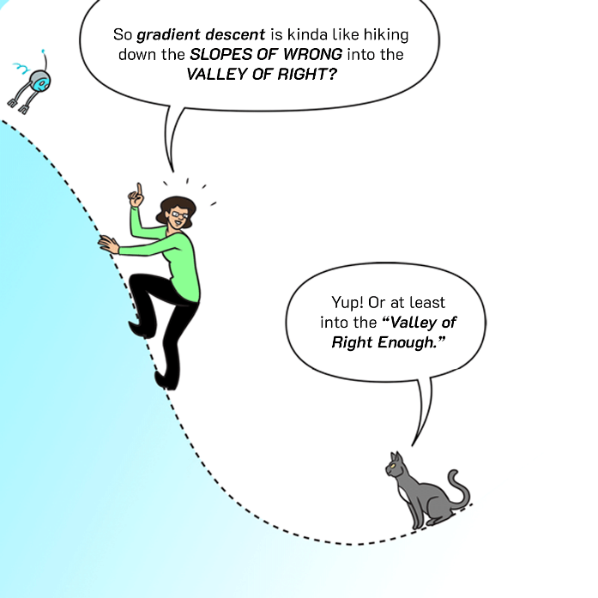
CSE 445: Machine Learning
Training Models
Instructor: Syed Athar Bin Amir, North South University

Slide 2
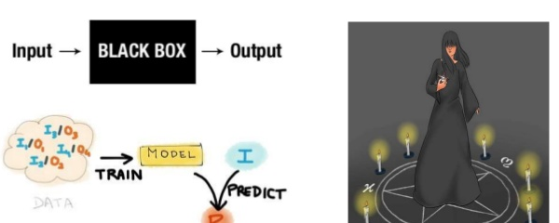
Course so far
Treated ML algorithms as black boxes (mostly)
Learned how to preprocess data, and how to evaluate ML models
Time to look under the hood!
Linear Regression
Gradient Descent
Polynomial Regression
Logistic Regression
Softmax Regression

Slide 3
Linear Regression
Two ways to train an LR model
Direct “closed-form” equation for computing model parameters
Yields the model parameters theta that provides the best fit directly – i.e. the parameters that minimize the cost function
Iterative optimization via Gradient Descent, or one of its variants (Batch GD, Mini-batch GD, Stochastic GD)
Gradually tweak the model parameters to minimize cost function of training set
Ideally will converge to the same set of parameters as the direct method

Slide 4
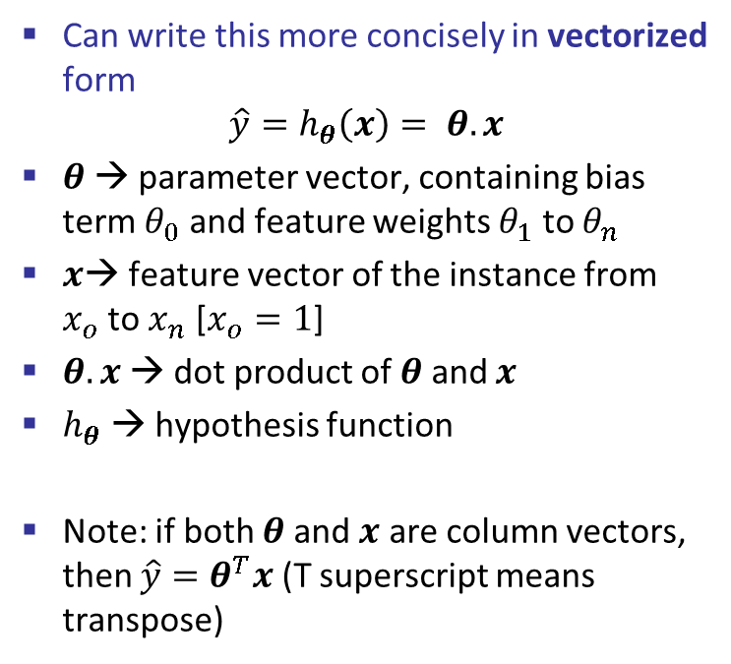
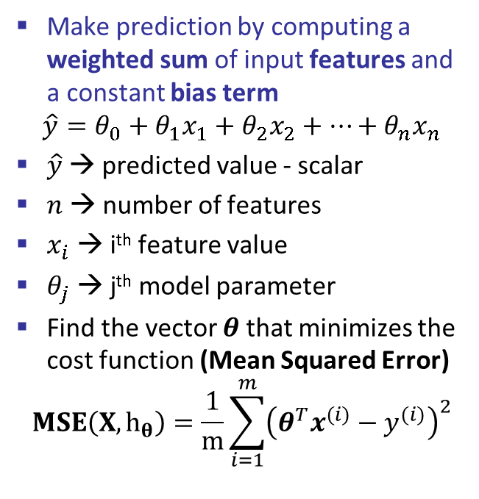
Linear Regression
Make prediction by computing a weighted sum of input features and a constant bias term
$$\hat{y}=θ_{0}+θ_{1}x_{1}+θ_{2}x_{2}+…+θ_{n}x_{n}$$
$\hat{y}$→ predicted value - scalar
$n$ → number of features
$x_{i}$ → i^{th} feature value
$θ_{j}$ → j^{th} model parameter
Find the vector $θ$ that minimizes the cost function (Mean Squared Error)
$$MSE\left(X,h_{θ}\right)=\frac{1}{m}\sum_{i=1}^{m}{{\left(θ^{T}x^{(i)}−y^{(i)}\right)}^{2}}$$
Can write this more concisely in vectorized form
$$\hat{y}=h_{θ}\left(x\right)= θ.x$$
$θ$ → parameter vector, containing bias term $θ_{0}$ and feature weights $θ_{1}$ to $θ_{n}$
$x$→ feature vector of the instance from $x_{o}$to $x_{n}$ [$x_{o}=1$]
$θ.x$ → dot product of $θ$ and $x$
$h_{θ}$ → hypothesis function
Note: if both $θ$ and $x$ are column vectors, then $\hat{y}=θ^{T}x$ (T superscript means transpose)

Slide 5

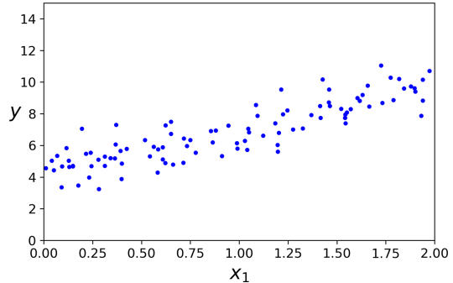
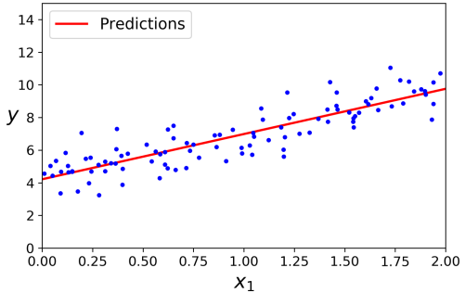


Closed Form: Normal Equation
Closed form solution for the value of $θ$ that minimizes the cost function
$$\hat{θ}={\left(X^{T}X\right)}^{−1}X^{T}y$$

Slide 6
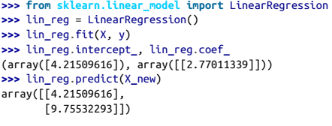


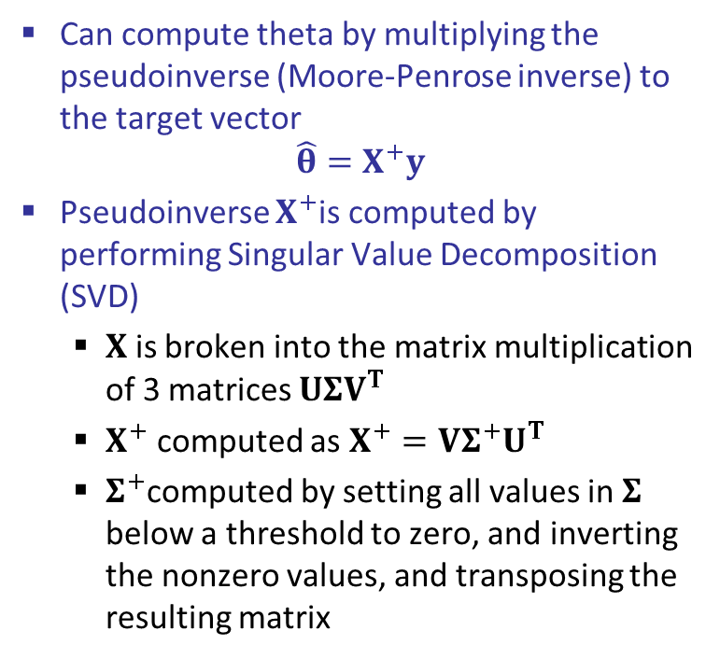
Closed Form: SVD Approach
Can compute theta by multiplying the pseudoinverse (Moore-Penrose inverse) to the target vector
$$\hat{θ}=X^{+}y$$
Pseudoinverse $X^{+}$is computed by performing Singular Value Decomposition (SVD)
$X$ is broken into the matrix multiplication of 3 matrices $UΣV^{T}$
$X^{+}$ computed as $X^{+}=VΣ^{+}U^{T}$
$Σ^{+}$computed by setting all values in $Σ$ below a threshold to zero, and inverting the nonzero values, and transposing the resulting matrix

Slide 7
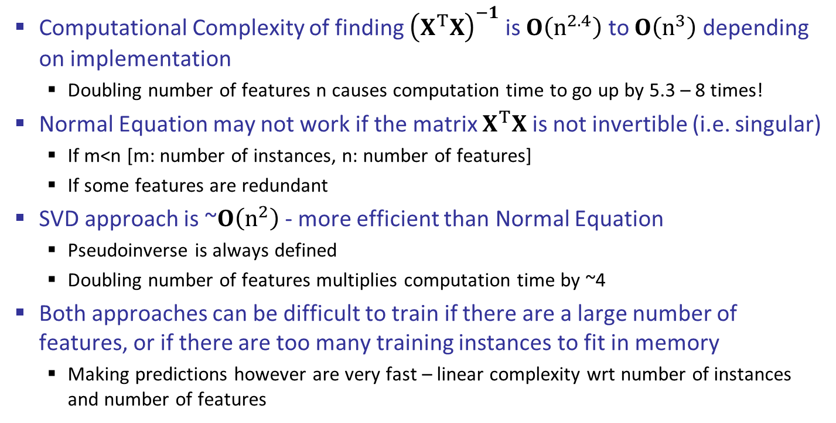
Normal Equation
Computational Complexity of finding ${\left(X^{T}X\right)}^{−1}$ is $O\left(n^{2.4}\right)$ to $O\left(n^{3}\right)$ depending on implementation
Doubling number of features n causes computation time to go up by 5.3 – 8 times!
Normal Equation may not work if the matrix $X^{T}X$ is not invertible (i.e. singular)
If m<n [m: number of instances, n: number of features]
If some features are redundant
SVD approach is ~$O\left(n^{2}\right)$ - more efficient than Normal Equation
Pseudoinverse is always defined
Doubling number of features multiplies computation time by ~4
Both approaches can be difficult to train if there are a large number of features, or if there are too many training instances to fit in memory
Making predictions however are very fast – linear complexity wrt number of instances and number of features

Slide 8
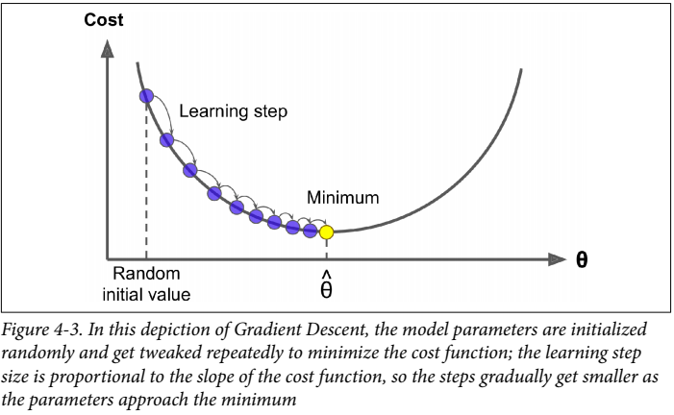
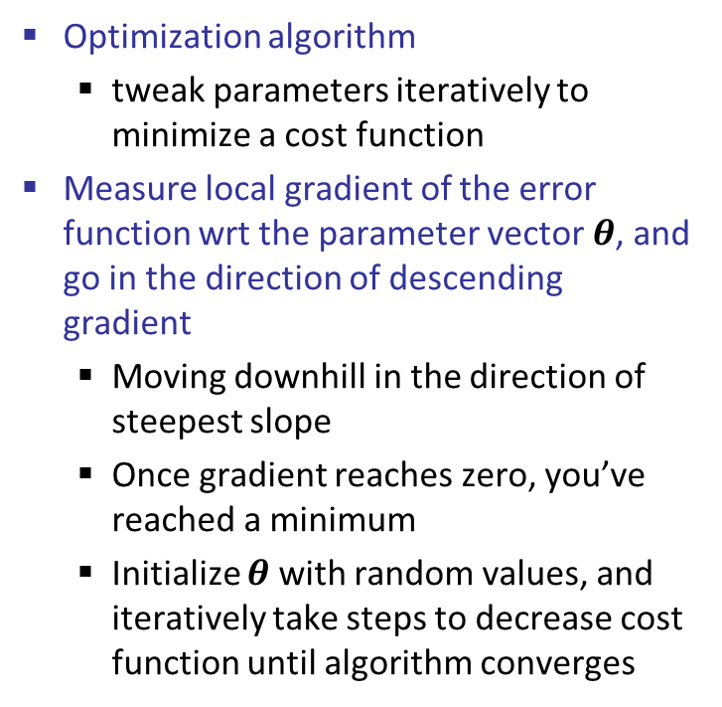
Gradient Descent
Optimization algorithm
tweak parameters iteratively to minimize a cost function
Measure local gradient of the error function wrt the parameter vector $θ$, and go in the direction of descending gradient
Moving downhill in the direction of steepest slope
Once gradient reaches zero, you’ve reached a minimum
Initialize $θ$ with random values, and iteratively take steps to decrease cost function until algorithm converges

Slide 9
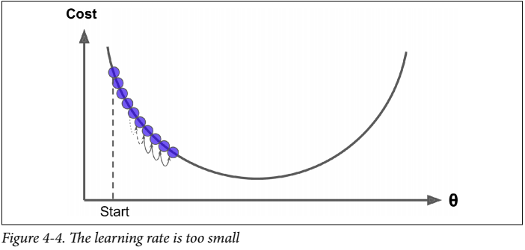
Gradient Descent – Low Learning Rate
Size of the steps determined by the learning rate hyperparameter
If learning rate is too low, the algorithm needs far too many iterations to converge

Slide 10
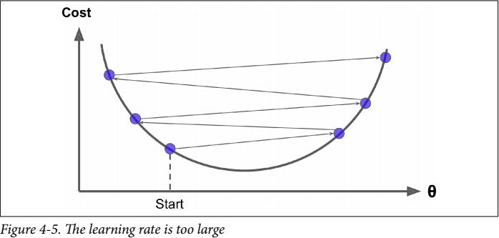
Gradient Descent – High Learning Rate
If learning rate is too high, you might jump across the valley and end up on other side → might make the algorithm diverge!

Slide 11
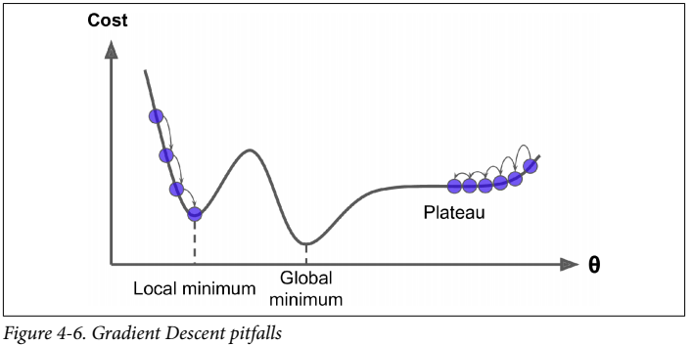
Gradient Descent – Nonconvex cost function
Cost function may not be a nice bowl with a single minimum - could have holes, ridges, plateaus etc
MSE cost function happens to be a convex function → pick any two points on the curve, and a straight line joining them will never intersect the curve

Slide 12
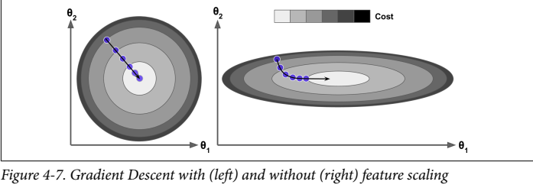
Gradient Descent – Feature Scaling
If features are not scaled, Gradient descent may take a long time to approach the global minimum
The more parameters in model → more dimensions in parameter space → harder to find global minimum

Slide 13
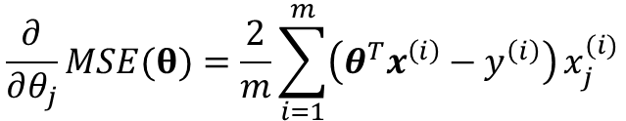
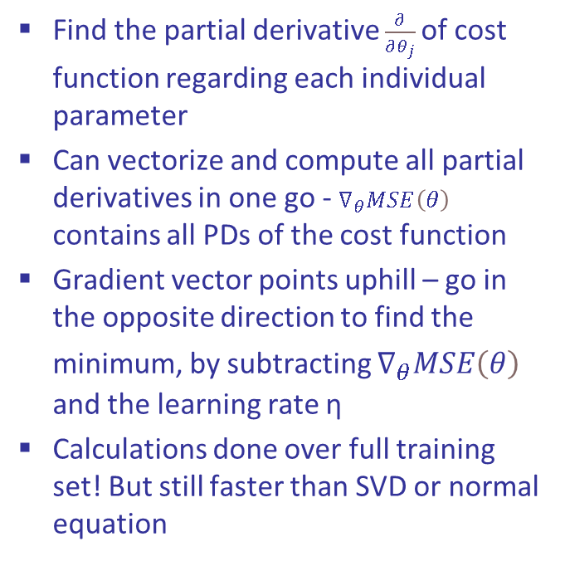

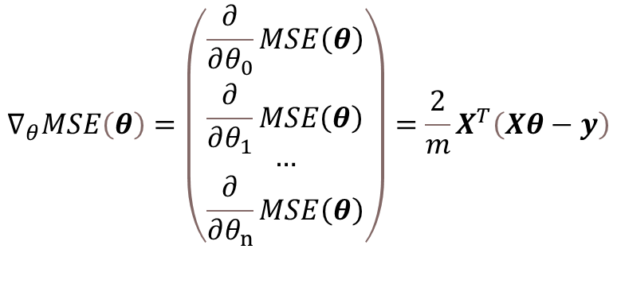
Batch Gradient Descent
Find the partial derivative $\frac{∂}{∂θ_{j}}$of cost function regarding each individual parameter
Can vectorize and compute all partial derivatives in one go - $∇_{θ}MSE\left(θ\right)$ contains all PDs of the cost function
Gradient vector points uphill – go in the opposite direction to find the minimum, by subtracting $∇_{θ}MSE\left(θ\right)$ and the learning rate η
Calculations done over full training set! But still faster than SVD or normal equation
$$\frac{∂}{∂θ_{j}}MSE(θ)=\frac{2}{m}\sum_{i=1}^{m}{\left(θ^{T}x^{\left(i\right)}−y^{\left(i\right)}\right)}x_{j}^{(i)}$$
$$∇_{θ}MSE\left(θ\right)=\left(\begin{matrix}\frac{∂}{∂θ_{0}}MSE\left(θ\right) \\ \frac{∂}{∂θ_{1}}MSE\left(θ\right) \\ … \\ \frac{∂}{∂θ_{n}}MSE\left(θ\right)\end{matrix}\right)=\frac{2}{m}X^{T}\left(Xθ−y\right)$$
$$θ=θ−η∇_{θ}MSE\left(θ\right)$$

Slide 14
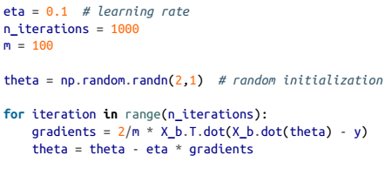
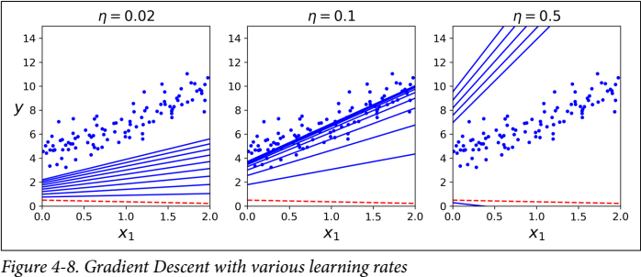

Learning Rate
Learning rate can affect speed of convergence significantly
Stop training when gradient vector becomes very tiny – when its norm is smaller than ϵ (tolerance)

Slide 15
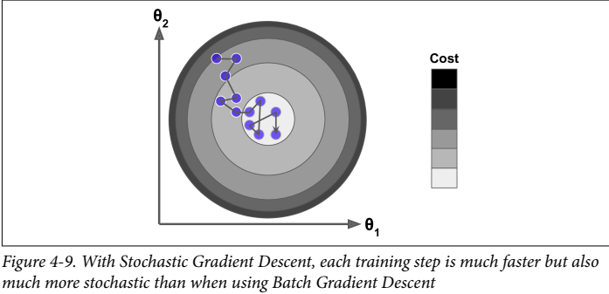
Stochastic Gradient Descent
Batch GD with full training set → very slow with large training sets!
Stochastic GD → random instance in training set picked at every step for gradient compute (only one instance in memory per iteration)
Only decreases on average – will bounce around optimal value
Good when cost function is very irregular
Reduce learning rate to help settle on minimum

Slide 16
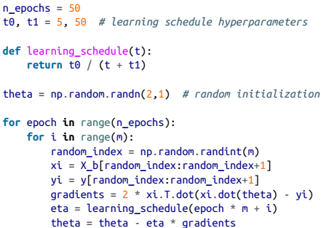
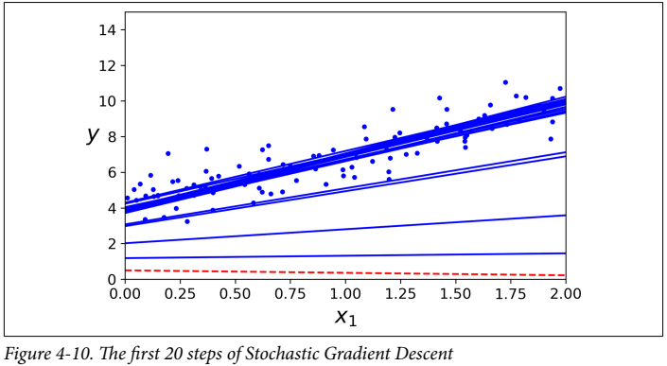


Stochastic Gradient Descent
Learning schedule → gradually lower learning rate
Epoch → each round of m iterations
Just 50 epochs total, instead of 1000 iterations through whole training set
Shuffling required to ensure instances are independent and identically distributed

Slide 17
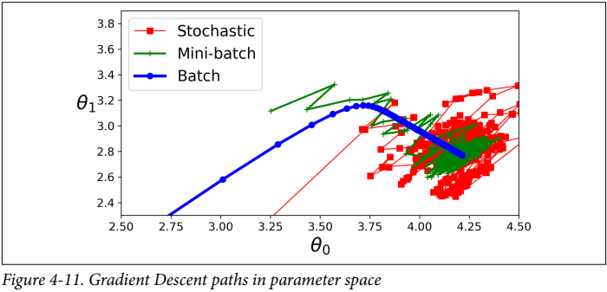
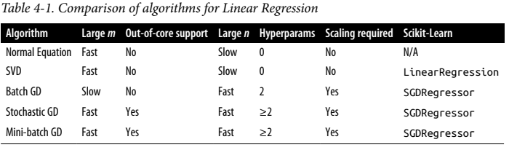
Mini-batch Gradient Descent
Compute gradients on small, random sets of instances called mini-batches.
Best of both worlds – computationally less expensive than Batch GD, and less erratic than Stochastic GD
Good learning schedule required to get to global minimum

Slide 18
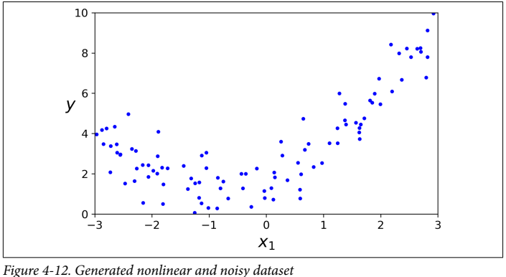

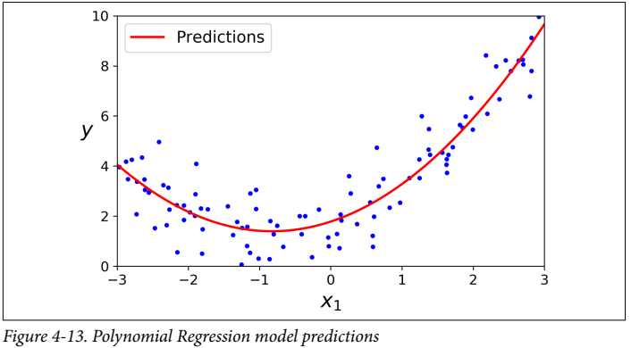
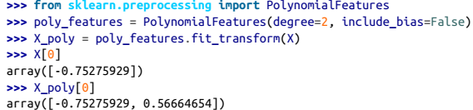

Polynomial Regression
Append powers of each feature as new features
Train a linear model on the extended set of features
Capable of finding relationships between features as well – not possible with just linear regression

Slide 19
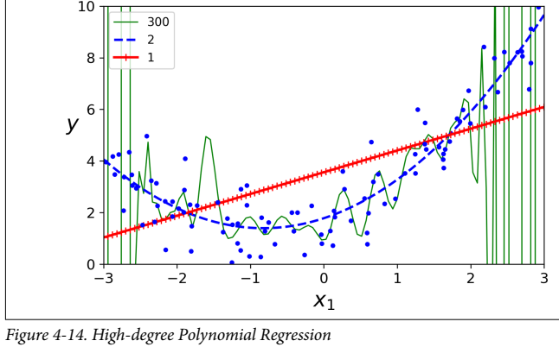
Is your model overfitting or underfitting?
High degree polynomial model → severe overfit
Linear model → severe underfit
One way to know is via cross validation
If model does well on training, but poorly on validation, it’s overfitting
If it’s poor on both, it’s underfitting
Alternative way is via Learning Curves
plots of model performance on training and validation set as a function of training set size or training iteration

Slide 20
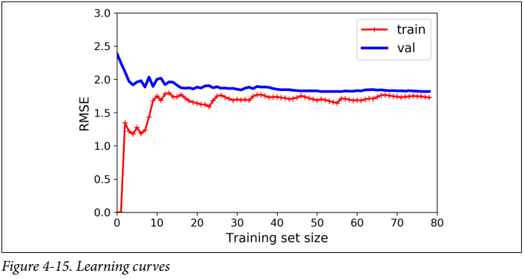
Learning Curves - Underfitting
Linear regression model fitted on quadratic data
Few instances → can be fit perfectly, so low RMSE when training set size is little
Error in training data goes up and plateaus – adding new instances doesn’t make the error change
Initial validation error large → model cannot generalize properly
Validation curve also plateaus and stays close to the training curve

Slide 21
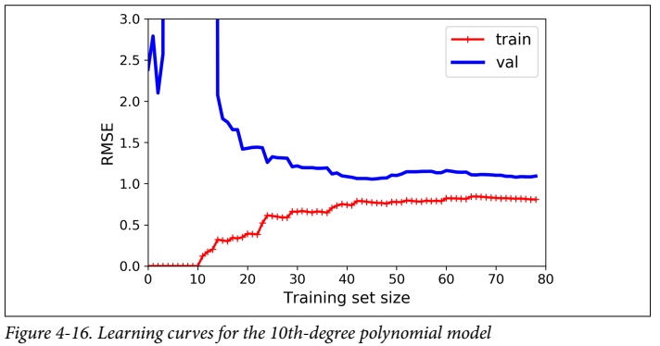
Learning Curves - Overfitting
10th degree polynomial model trained on quadratic data
Error on training data is much lower
Significant gap between training and validation curves → i.e. the model performs much better on the training set than on the validation set
Can be improved by feeding more training data until the two curves start to get closer

Slide 22
Bias/Variance Trade-off
ML model’s generalization error comes from three sources:
Bias → generalization error due to wrong assumptions
e.g. assuming the data is linear when it’s actually quadratic
High bias will lead to underfitting
Variance → high sensitivity to small variations in training data
e.g. polynomial model with many degrees of freedom on quadratic data
High variance leads to overfitting
Irreducible error → due to inherent noise of the data itself
Make models more complex → higher variance, lower bias, overfitting
Make models less complex → lower variance, higher bias, underfitting
Need to strike a very delicate balance between the two

Slide 23
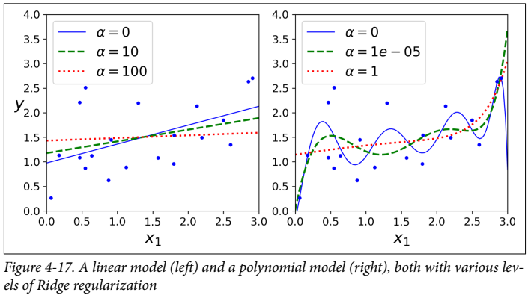

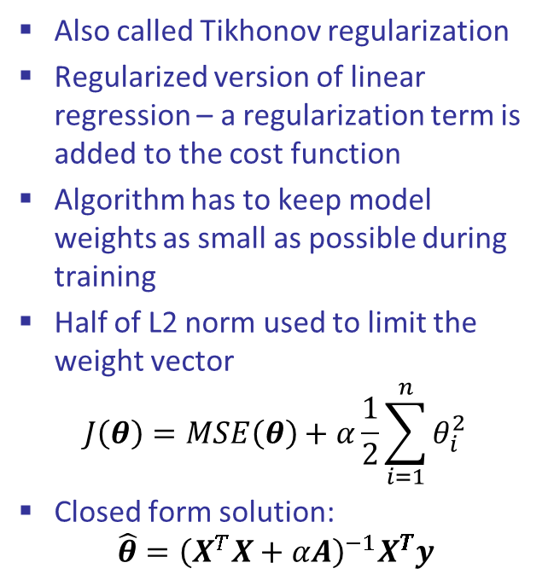
Ridge Regression
Also called Tikhonov regularization
Regularized version of linear regression – a regularization term is added to the cost function
Algorithm has to keep model weights as small as possible during training
Half of L2 norm used to limit the weight vector
$$J\left(θ\right)=MSE\left(θ\right)+α\frac{1}{2}\sum_{i=1}^{n}{θ_{i}^{2}}$$
Closed form solution:
$$\hat{θ}={\left(X^{T}X+αA\right)}^{−1}X^{T}y$$

Slide 24
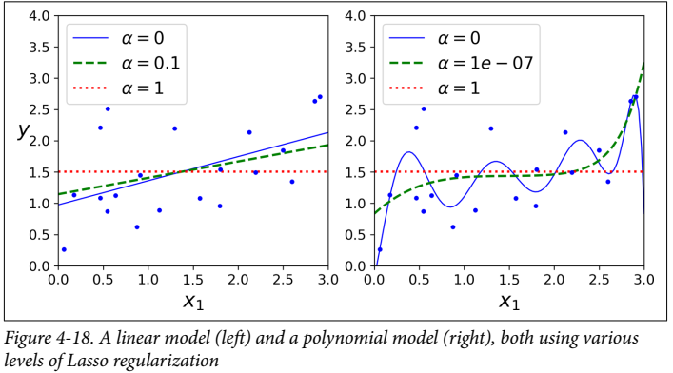
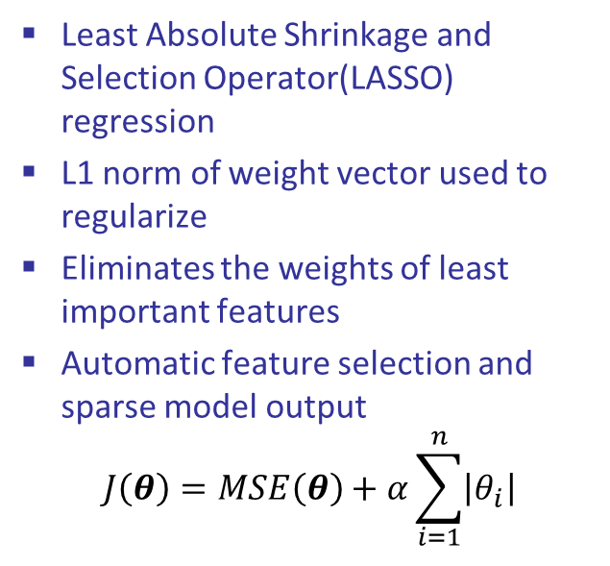
Lasso Regression
Least Absolute Shrinkage and Selection Operator(LASSO) regression
L1 norm of weight vector used to regularize
Eliminates the weights of least important features
Automatic feature selection and sparse model output
$$J\left(θ\right)=MSE\left(θ\right)+α\sum_{i=1}^{n}{\left|θ_{i}\right|}$$

Slide 25
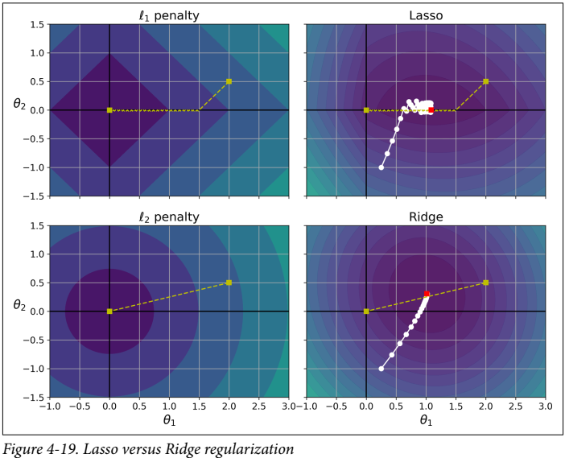
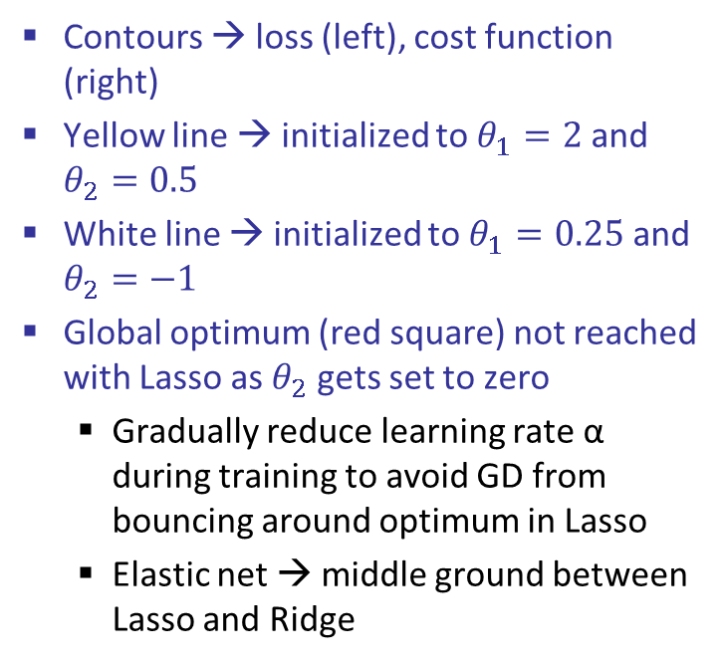
Lasso vs Ridge
Contours → loss (left), cost function (right)
Yellow line → initialized to $θ_{1}=2$ and $θ_{2}=0.5$
White line → initialized to $θ_{1}=0.25$ and $θ_{2}=−1$
Global optimum (red square) not reached with Lasso as $θ_{2}$ gets set to zero
Gradually reduce learning rate α during training to avoid GD from bouncing around optimum in Lasso
Elastic net → middle ground between Lasso and Ridge

Slide 26
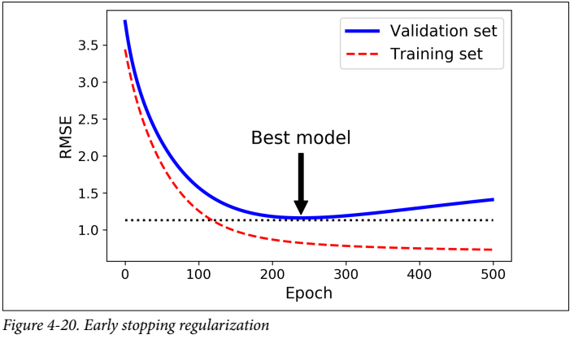
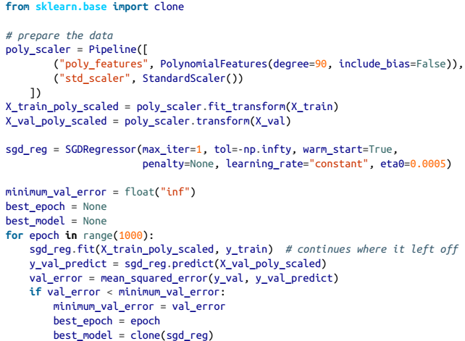
Early Stopping
Stop training as soon as validation error reaches a minimum
When validation RMSE begins to go up whilst training RMSE is still going down, that indicates overfitting

Slide 27
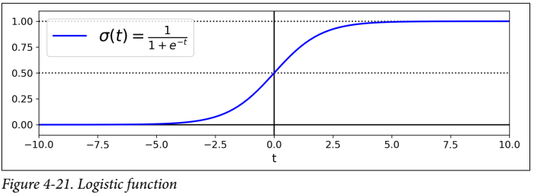
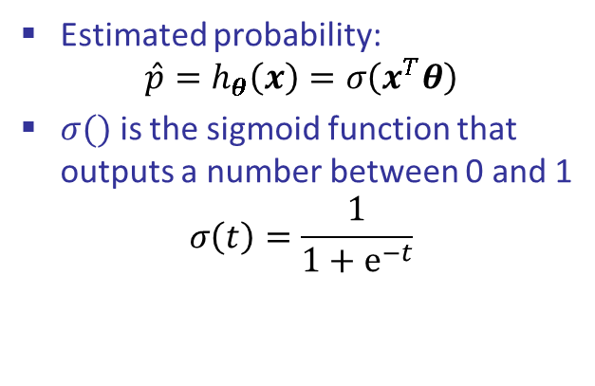

Logistic Regression
Binary classifier- also called Logit Regression, but used in classification tasks
The probability that an instance belongs to a particular class is estimated
If estimated probability is more than 50%, the model predicts the instance to belong to that class – otherwise, it predicts it does not belong to that class
Estimated probability:
$$\hat{p}=h_{θ}\left(x\right)=σ\left(x^{T}θ\right)$$
$σ()$ is the sigmoid function that outputs a number between 0 and 1
$$σ\left(t\right)=\frac{1}{1+ⅇ^{−t}}$$
$$\hat{y}=\left\{\begin{aligned}0 if\hat{p}<0.5 \\ 1 if \hat{p}≥0.5\end{aligned} \right.$$

Slide 28
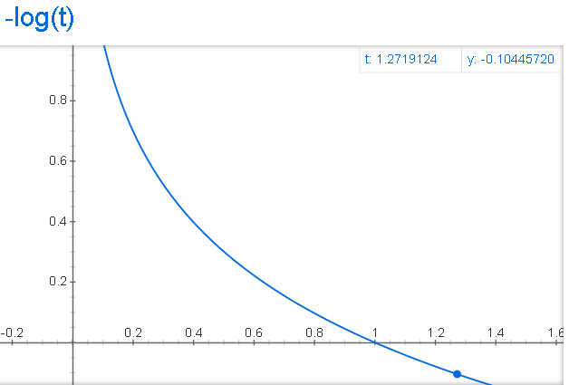
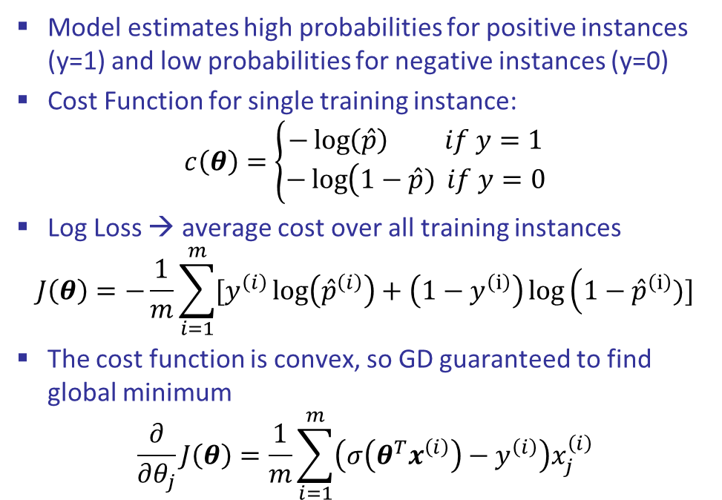
Logistic Regression Training
Model estimates high probabilities for positive instances (y=1) and low probabilities for negative instances (y=0)
Cost Function for single training instance:
$$c\left(θ\right)=\left\{\begin{matrix}−\log\left(\hat{p}\right) if y=1 \\ −\log\left(1−\hat{p}\right.) if y=0\end{matrix}\right.$$
Log Loss → average cost over all training instances
$$J\left(θ\right)=−\frac{1}{m}\sum_{i=1}^{m}{[y^{\left(i\right)}\log\left({\hat{p}}^{\left(i\right)}\right)}+\left(1−y^{\left(ⅈ\right)}\right)\log\left(1−{\hat{p}}^{\left(ⅈ\right)}\right.)]$$
The cost function is convex, so GD guaranteed to find global minimum
$$\frac{∂}{∂θ_{j}}J\left(θ\right)=\frac{1}{m}\sum_{i=1}^{m}{\left(σ\left(θ^{T}x^{\left(i\right)}\right)−y^{\left(i\right)}\right)x_{j}^{\left(i\right)}}$$

Slide 29
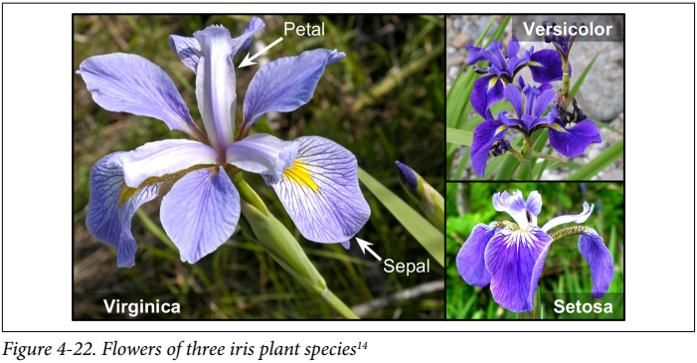
Logistic Regression example – Iris flower classifier
Classify iris flowers of three different species

Slide 30
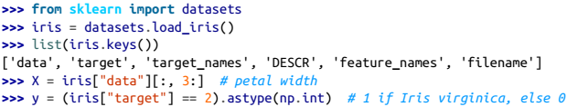

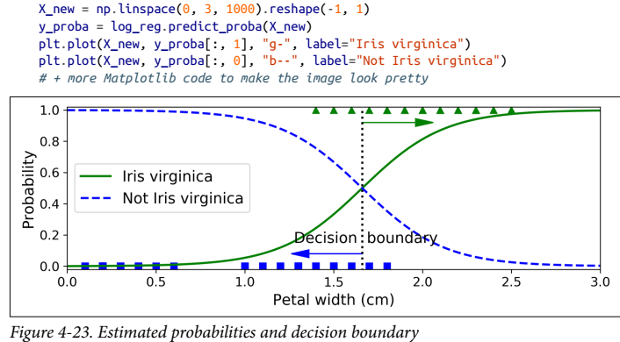
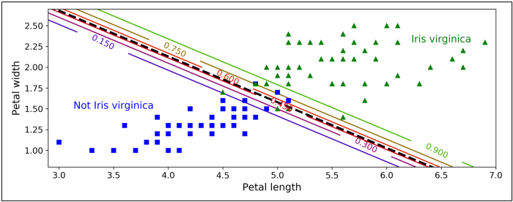
Logistic Regression example
Binary classifier for iris virginica flowers
Overlap between 1.4cm and 1.8cm width
Decision boundary at 1.6cm
Trained on two features → can see linear boundary where model estimates 50% probability

Slide 31
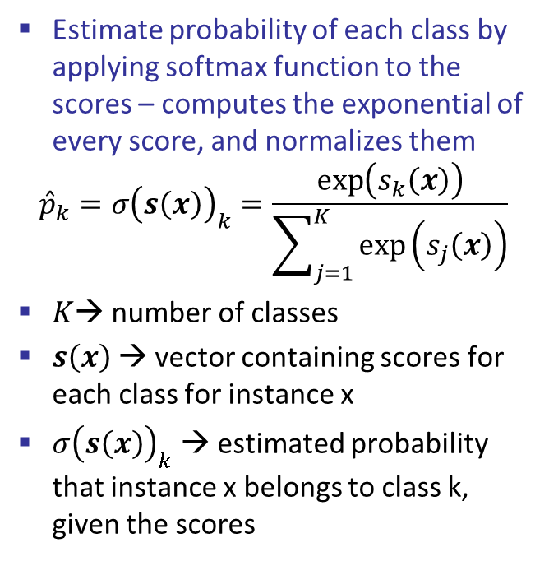


Softmax Regression
Also called Multiclass Logistic Regression/ Multinomial Logistic Regression
Generalization of Logistic Regression to support multiple classes directly
Compute a score $s_{k}\left(x\right)$for each class k
$$s_{k}\left(x\right)=x^{T}θ^{\left(k\right)}$$
Estimate probability of each class by applying softmax function to the scores – computes the exponential of every score, and normalizes them
$${\hat{p}}_{k}=σ{\left(s\left(x\right)\right)}_{k}=\frac{\exp\left(s_{k}\left(x\right)\right)}{\sum_{j=1}^{K}{\exp\left(s_{j}\left(x\right)\right)}}$$
$K$→ number of classes
$s\left(x\right)$ → vector containing scores for each class for instance x
$σ{\left(s\left(x\right)\right)}_{k}$ → estimated probability that instance x belongs to class k, given the scores
Predicts the class with the highest estimated probability (like logistic regression)
$$\hat{y}=\underset{k}{argmax} σ{\left(s\left(x\right)\right)}_{k}$$
$$=\underset{k}{argmax} s_{k}(x)$$
$$=\underset{k}{argmax} ({(θ^{\left(k\right)})}^{T}x)$$
Note: argmax returns the value of k that maximizes the estimated probability

Slide 32


Softmax Regression – Cross Entropy
Objective is to have model that estimates high prob. for target class, and low for the others
Cost Function used is called cross entropy – penalizes the model when it estimates low prob. for target class
$$J\left(Θ\right)=−\frac{1}{m}\sum_{i=1}^{m}{\sum_{k=1}^{K}{y_{k}^{\left(i\right)}\log\left({\hat{ρ}}_{k}^{\left(i\right)}\right)}}$$
$y_{k}^{\left(i\right)}$ is the target probability that i^{th} instance belongs to class k (either 1 or 0), and $Θ$ is the parameter matrix
For a case with two classes only, this function reduces down to the log loss function for Logistic Regression
Gradient vector of this cost function wrt $θ^{\left(k\right)}$ is given as follows:
$$∇_{θ^{\left(k\right)}}J\left(Θ\right)=\frac{1}{m}\sum_{i=1}^{m}{\left({\hat{p}}_{k}^{\left(i\right)}−y_{k}^{\left(i\right)}\right)x^{\left(i\right)}}$$
Can use this to compute gradient vectors for each class, and use gradient descent (or any other optimizer) to find parameter matrix $Θ$ that minimizes cost function

Slide 33



Softmax Regression – Iris Petals
Can choose Softmax Regression by setting multi_class=“multinomial”
L-BGFS optimizer
L2 regularization by default
Q: which flower are we looking at if:
width = 2cm, length=5cm
width = 1cm, length=1cm
width = 3cm, length=2.5cm

